Slide 1
Chapter 2
Process Models

Slide 2
Development Models
Waterfall models

Slide 3
Waterfall model
First SDLC Model
Linear Sequential Model
Simple to understand and easy to implement

Slide 4
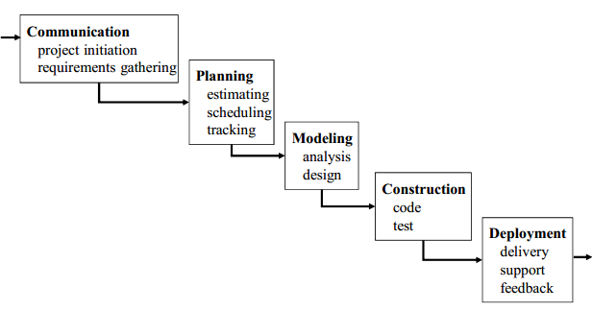

Slide 5
ADVANTAGES
DISADVANTAGES
Simple & Easy to Understand
Difficult to go Back and Change something
Easy to Manage
No Working Software until Late Stages of SDLC
Phase don’t Overlap
Risk and Uncertainty
Best for Small Projects
Not Suitable for Complex and Object Oriented Projects

Slide 6
Impact on testing
Testing Starts late in the SDLC
Single Testing Phase
Leads to “blocking Stages”

Slide 7
Development Models
Incremental process modes

Slide 8
Incremental process modes
Combines elements of the waterfall model applied in an iterative fashion
Each linear sequence produces deliverable “increments” of the software
The first increment is often a core product
The core product is used by the customer (or undergoes detailed evaluation)
Based on evaluation results, a plan is developed for the next increment

Slide 9
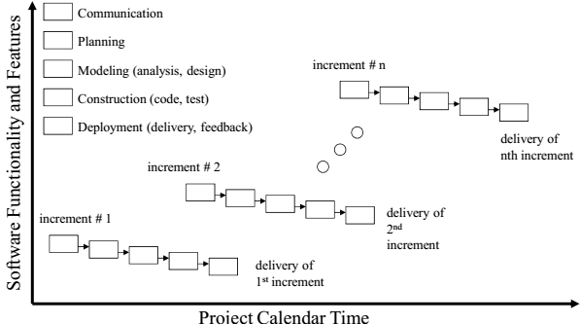

Slide 10
ADVANTAGES
DISADVANTAGES
Generates working software quickly and early during the software life cycle
Needs good planning and design
This model is more flexible – less costly to change scope and requirements. It is easier to test and debug during a smaller iteration
Needs a clear and complete definition of the whole system before it can be broken down and built incrementally
In this model customer can respond to each built. Lowers initial delivery cost
Total cost is higher than waterfall
Easier to manage risk because risky pieces are identified and handled during it’d iteration

Slide 11
When to use
This model can be used when the requirements of the complete system are clearly defined and understood
Major requirements must be defined; however, some details can evolve with time
There is a need to get a product to the market early
A new technology is being used
Resources with needed skill set are not available

Slide 12
Development Models
RAD model

Slide 13
THE RAD model
RAD model is Rapid Application Development model.
It is a type of incremental model. In RAD model the components or functions are developed in parallel as if they were mini projects.
Uses a component-based construction approach
This can quickly give the customer something to see and use and to provide feedback regarding the delivery and their requirements if requirements are well understood and project scope is constrained

Slide 14
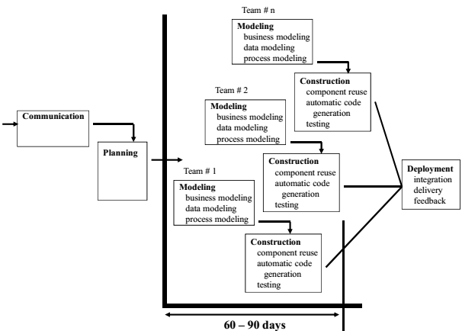

Slide 15
ADVANTAGES
DISADVANTAGES
Reduced development time
Depends on strong team and individual performances for identifying business requirements
Increases reusability of components
Only system that can be modularized can be built using RAD
Quick initial reviews occur & Encourages customer feedback
Requires skilled developers/designers & High dependency on modeling skills
Integration from very beginning solves a lot of integration issues
Inapplicable to cheaper projects as cost of modeling and automated code generation is very high

Slide 16
When to use
RAD should be used when there is a need to create a system that can be modularized in 2-3 months of time
It should be used if there’s high availability of designers for modeling and the budget is high enough to afford their cost along with the cost of automated code generating tools
RAD SDLC model should be chosen only if resources with high business knowledge are available and there is a need to produce the system in a short span of time (2-3 months)

Slide 17
Evolutionary process models
Evolutionary models are iterative type models
Software, like all complex systems, evolves over a period of time
Allow to develop more complete versions of the software
Different Evolutionary Process Models
The Prototyping Model
The Spiral Model
Concurrent Development Model

Slide 18
The Prototyping model
Prototype is defined as first or preliminary form using which other forms are copied or derived
Prototype model is a set of general objectives for software
It does not identify the requirements like detailed input, output
It is software working model of limited functionality & working programs are quickly produced

Slide 19
Quick Plan
Construction of Prototype
Deployment, Delivery & Feedback
Modeling Quick Design
Communication
Notes:
Communication In this phase, developer and customer meet and discuss the overall objectives of the software.
2. Quick design
Quick design is implemented when requirements are known.
It includes only the important aspects like input and output format of the software.
It focuses on those aspects which are visible to the user rather than the detailed plan.
It helps to construct a prototype.
3. Modeling quick design
This phase gives the clear idea about the development of software because the software is now built.
It allows the developer to better understand the exact requirements.
4. Construction of prototype The prototype is evaluated by the customer itself. 5. Deployment, delivery, feedback
If the user is not satisfied with current prototype then it refines according to the requirements of the user.
The process of refining the prototype is repeated until all the requirements of users are met.
When the users are satisfied with the developed prototype then the system is developed on the basis of final prototype.

Slide 20
ADVANTAGES
DISADVANTAGES
Prototype model need not know the detailed input, output, processes, adaptability of operating system and full machine interaction
The client involvement is more and it is not always considered by the developer
In the development process of this model users are actively involved
It is a slow process because it takes more time for development
Errors are detected much earlier.
Gives quick user feedback for better solutions.
Practically, this methodology may increase the complexity of the system as scope of the system may expand beyond original plans
It identifies the missing functionality easily. It also identifies the confusing or difficult functions
Incomplete application may cause application not to be used as the full system was designed Incomplete or inadequate problem analysis.

Slide 21
When to use
Prototype model should be used when the desired system needs to have a lot of interaction with the end users
Typically, online systems, web interfaces have a very high amount of interaction with end users, are best suited for Prototype model. It might take a while for a system to be built that allows ease of use and needs minimal training for the end user
Prototyping ensures that the end users constantly work with the system and provide a feedback which is incorporated in the prototype to result in a useable system. They are excellent for designing good human computer interface systems

Slide 22
Development Models
Spiral Sdlc model

Slide 23
Spiral sdlc model
The spiral model is similar to the incremental model, with more emphasis placed on risk analysis
Adds risk analysis, RAD & prototyping to the waterfall model
Each cycle involves the same sequence of step as the waterfall process model.

Slide 24
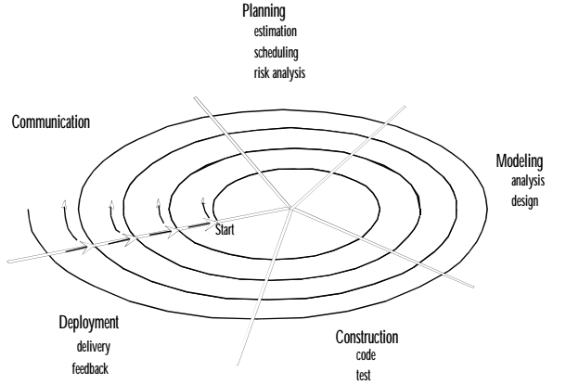

Slide 25
ADVANTAGES
DISADVANTAGES
High amount of risk analysis hence, avoidance of Risk is enhanced
Can be a costly model to use
Good for large and mission-critical projects
Risk analysis requires highly specific expertise
Strong approval and documentation control
Project’s success is highly dependent on the risk analysis phase
Additional Functionality can be added at a later date & Software is produced early in the software life cycle
Doesn’t work well for smaller projects

Slide 26
When to use
When costs and risk evaluation is important
For medium to high-risk projects
Long-term project commitment unwise because of potential changes to economic priorities
Users are unsure of their needs
Requirements are complex
Significant changes are expected (research and exploration)

Slide 27
The concurrent development model
The concurrent development model is called as concurrent model
The communication activity has completed in the first iteration and exits in the awaiting changes state
The modeling activity completed its initial communication and then go to the underdevelopment state
If the customer specifies the change in the requirement, then the modeling activity moves from the under development state into the awaiting change state
The concurrent process model activities moving from one state to another state

Slide 28
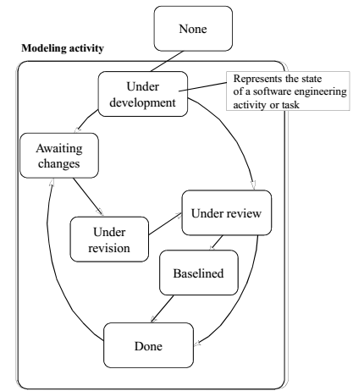

Slide 29
Weaknesses of evolutionary process models
Uncertainty in the number of total cycles required – Most project management and estimation techniques are based on linear layouts of activities
Do not establish the maximum speed of the evolution
Software processes should be focused on flexibility and extensibility rather than on high quality, which sounds scary

Slide 30
The unified process model (UP)
It is a use-cse driven, architecture-centric, iterative and incremental software process
UP is an attempt to draw on the best features and characteristics of conventional s/w process models
Also implements many of the best principles of agile software development
UP is a framework for object-oriented software engineering using UML (Unified Modeling Language)

Slide 31
Phases of up - inception
Encompasses both customer communication and planning activities
Fundamental business requirements are described through a set of preliminary usecases – A use-case describes a sequence of actions that are performed by an actor (e.g., a person, a machine, another system) as the actor interacts with the software
A rough architecture for the system is also proposed

Slide 32
Phases of UP - Elaboration
Encompasses customer communication and modeling activities
Refines and expands the preliminary use-cases
Expands the architectural representation to include five different views of the software – The use-case model – The analysis model – The design model – The implementation model – The deployment model
In some cases, elaboration creates an “executable architectural baseline” that represents a “first cut” executable system

Slide 33
Phases of UP - Construction
Makes each use-case operational for end-users
As components are being implemented, unit tests are designed and executed for each
Integration activities (component assembly and integration testing) are conducted
Use-cases are used to derive a suite of acceptance tests

Slide 34
Phases of UP - Transition
Software is given to end-users for beta testing
The software team creates the necessary support information – – User manuals – Trouble-shooting guides – Installation procedures
At the conclusion of the transition phase, the software increment becomes a usable software release

Slide 35
Phases of UP - Production
Coincides with the deployment activity of the generic process
The on-going use of the software is monitored
Support for the operating environment (infrastructure) is provided
Defect reports and requests for changes are submitted and evaluated

